Slide 1
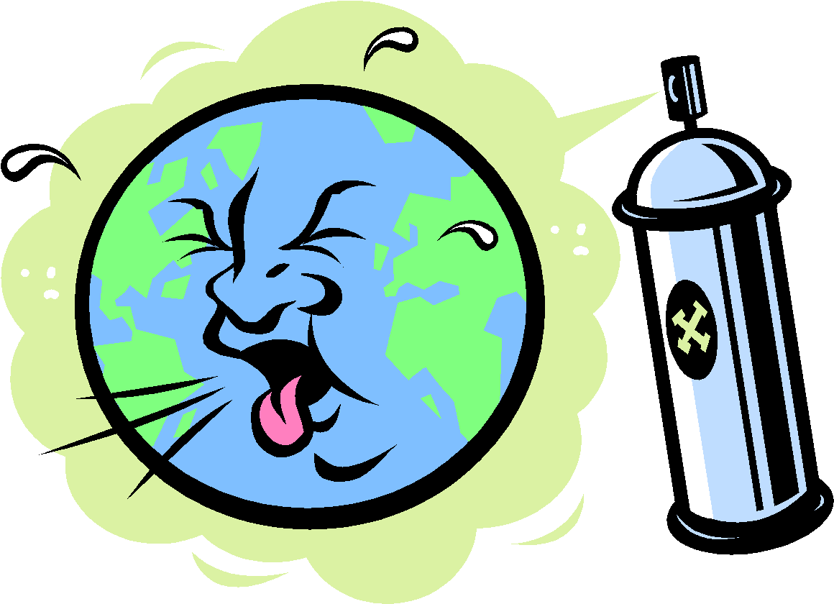
Pollution

Slide 2
Table of contents
Types of pollution
Air Pollution
Water Pollution
Soil Pollution
Noise Pollution
Light pollution
Thermal pollution

Slide 3
There are various types of pollution chiefly arising as a result of anthropogenic causes. Also contributing to pollution is globalization , where humanity’s constant need for natural resources has slowly started to change the face of the earth.
Though the quality of living has drastically improved, other new issues have risen that gradually impact human health and the environment. In this article, we shall explore the meaning, causes and types of pollution. Also, we shall analyses the repercussions of pollution on human health and the environment.

Slide 4
What is Pollution?
“Pollution is the introduction of substances (or energy) that cause adverse changes in the environment and living entities .”
Pollution need not always be caused by chemical substances such as particulates (like smoke and dust). Forms of energy such as sound, heat or light can also cause pollution. These substances that cause pollution are called pollutants.
Pollution, even in minuscule amounts, impacts the ecological balance. Pollutants can make their way up the food chain and eventually find their way inside the human body. Read on to explore the types of pollution and their implications.

Slide 5
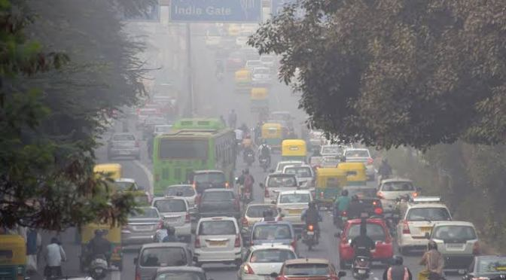
Air pollution
The air in our atmosphere has a roughly stable chemical composition consisting of nitrogen, oxygen, argon, carbon dioxide, and trace amounts of other gases. Any change in the air composition due to the addition of unwanted gases such as sulfur dioxide, carbon monoxide, and nitrogen oxides, chemicals, particulate matter, and biological molecules is called air pollution.

Slide 6
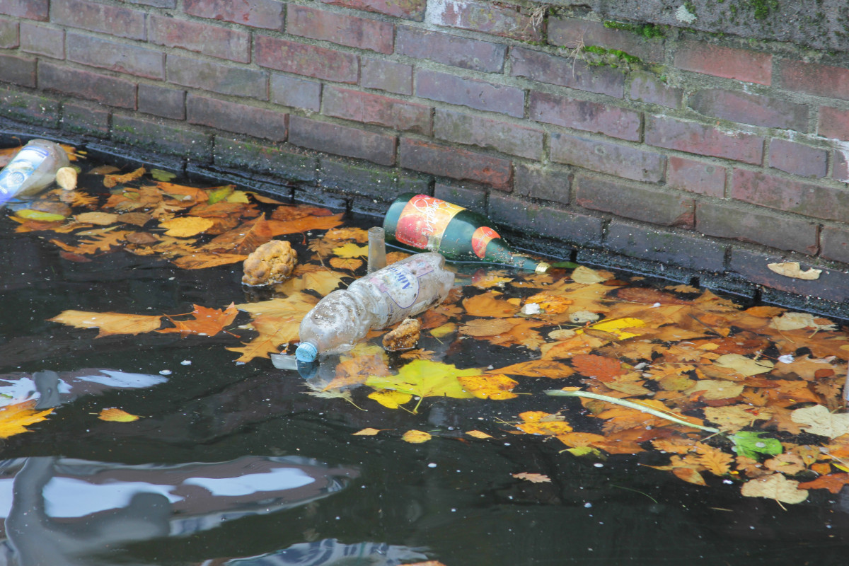
Water pollution
Water pollution occurs when toxic pollutants and particulate matter are introduced into water bodies such as oceans, rivers, lakes, ponds, and aquifers, making them impure and toxic. These contaminants are primarily generated by human activities and sometimes by natural disasters.
Among all other types of pollution, water pollution is found to have the maximum adverse consequences on the ecosystem.

Slide 7
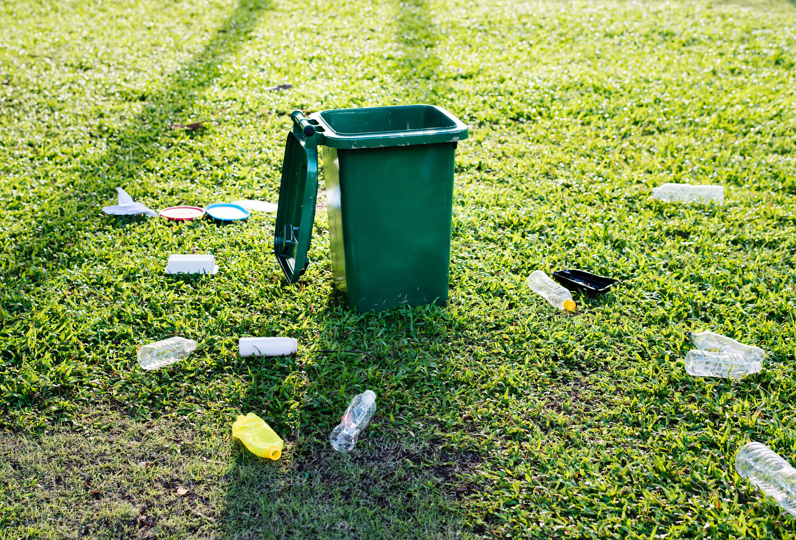
Soil pollution
Sometimes called land pollution, it refers to the degradation of land quality due to unwanted chemicals and other factors in the soil. Such chemicals change the soil’s chemical and biological properties, thus affecting plant growth. Green plants, being the primary producer, absorb those pollutants, which are then passed through the food chain, affecting the whole ecosystem.
Soil pollution can seep into groundwater or run off to the nearest streams and lakes, creating a vicious pollution cycle.

Slide 8

Noise pollution
It refers to the excessive amount of sound in the surroundings disrupting the natural balance. The acceptable amount of sound is about 60 to 65 decibels, which is the same as our everyday conversation.
Sound levels above 85 decibels are harmful depending on the duration of exposure. Noise above 140 decibels can cause permanent hearing loss. Also, the duration of exposure to the sound is found to have negative health impacts

Slide 9
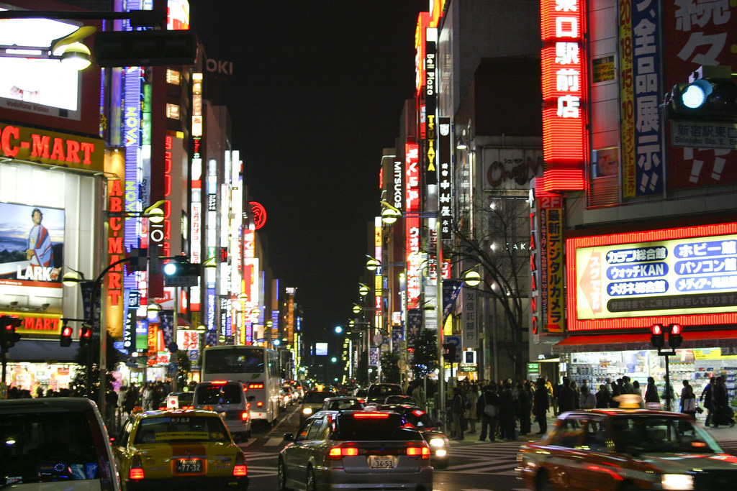
Light pollution
Light pollution refers to the excessive amount of light in the night sky. It occurs due to excessive, misdirected, and inefficient lighting systems by humans. It is also called photo pollution that disrupts the ecosystem by reducing the distinction between night and day.
Although light pollution seems to have a lesser impact than any other form, it is expected to have consequences similar to air or water pollution

Slide 10
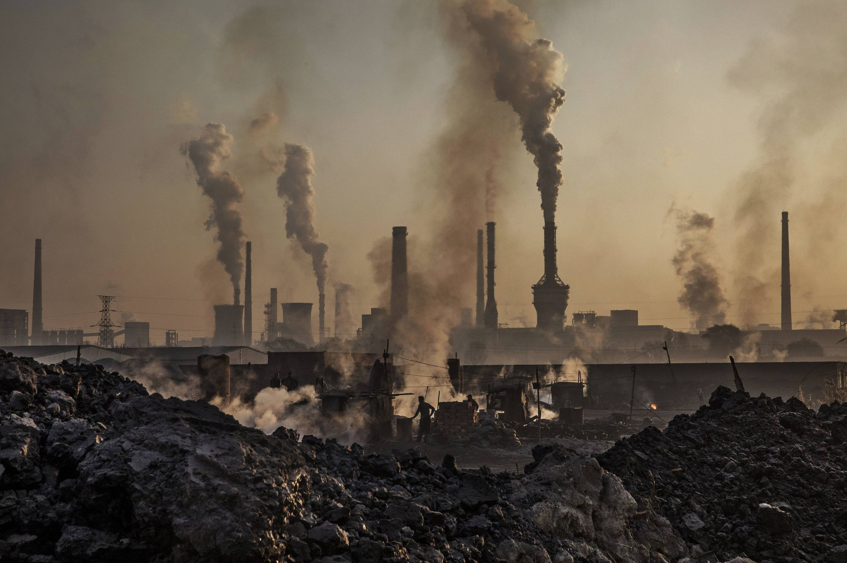
Thermal pollution
Thermal pollution is a rapid change in temperature in a natural body of water. This pollution is most often caused by heated discharge from an industrial facility or another human activity. Thermal pollution can result in disruptions in natural systems and stress, disease, or even death for affected organisms

